Slide 1
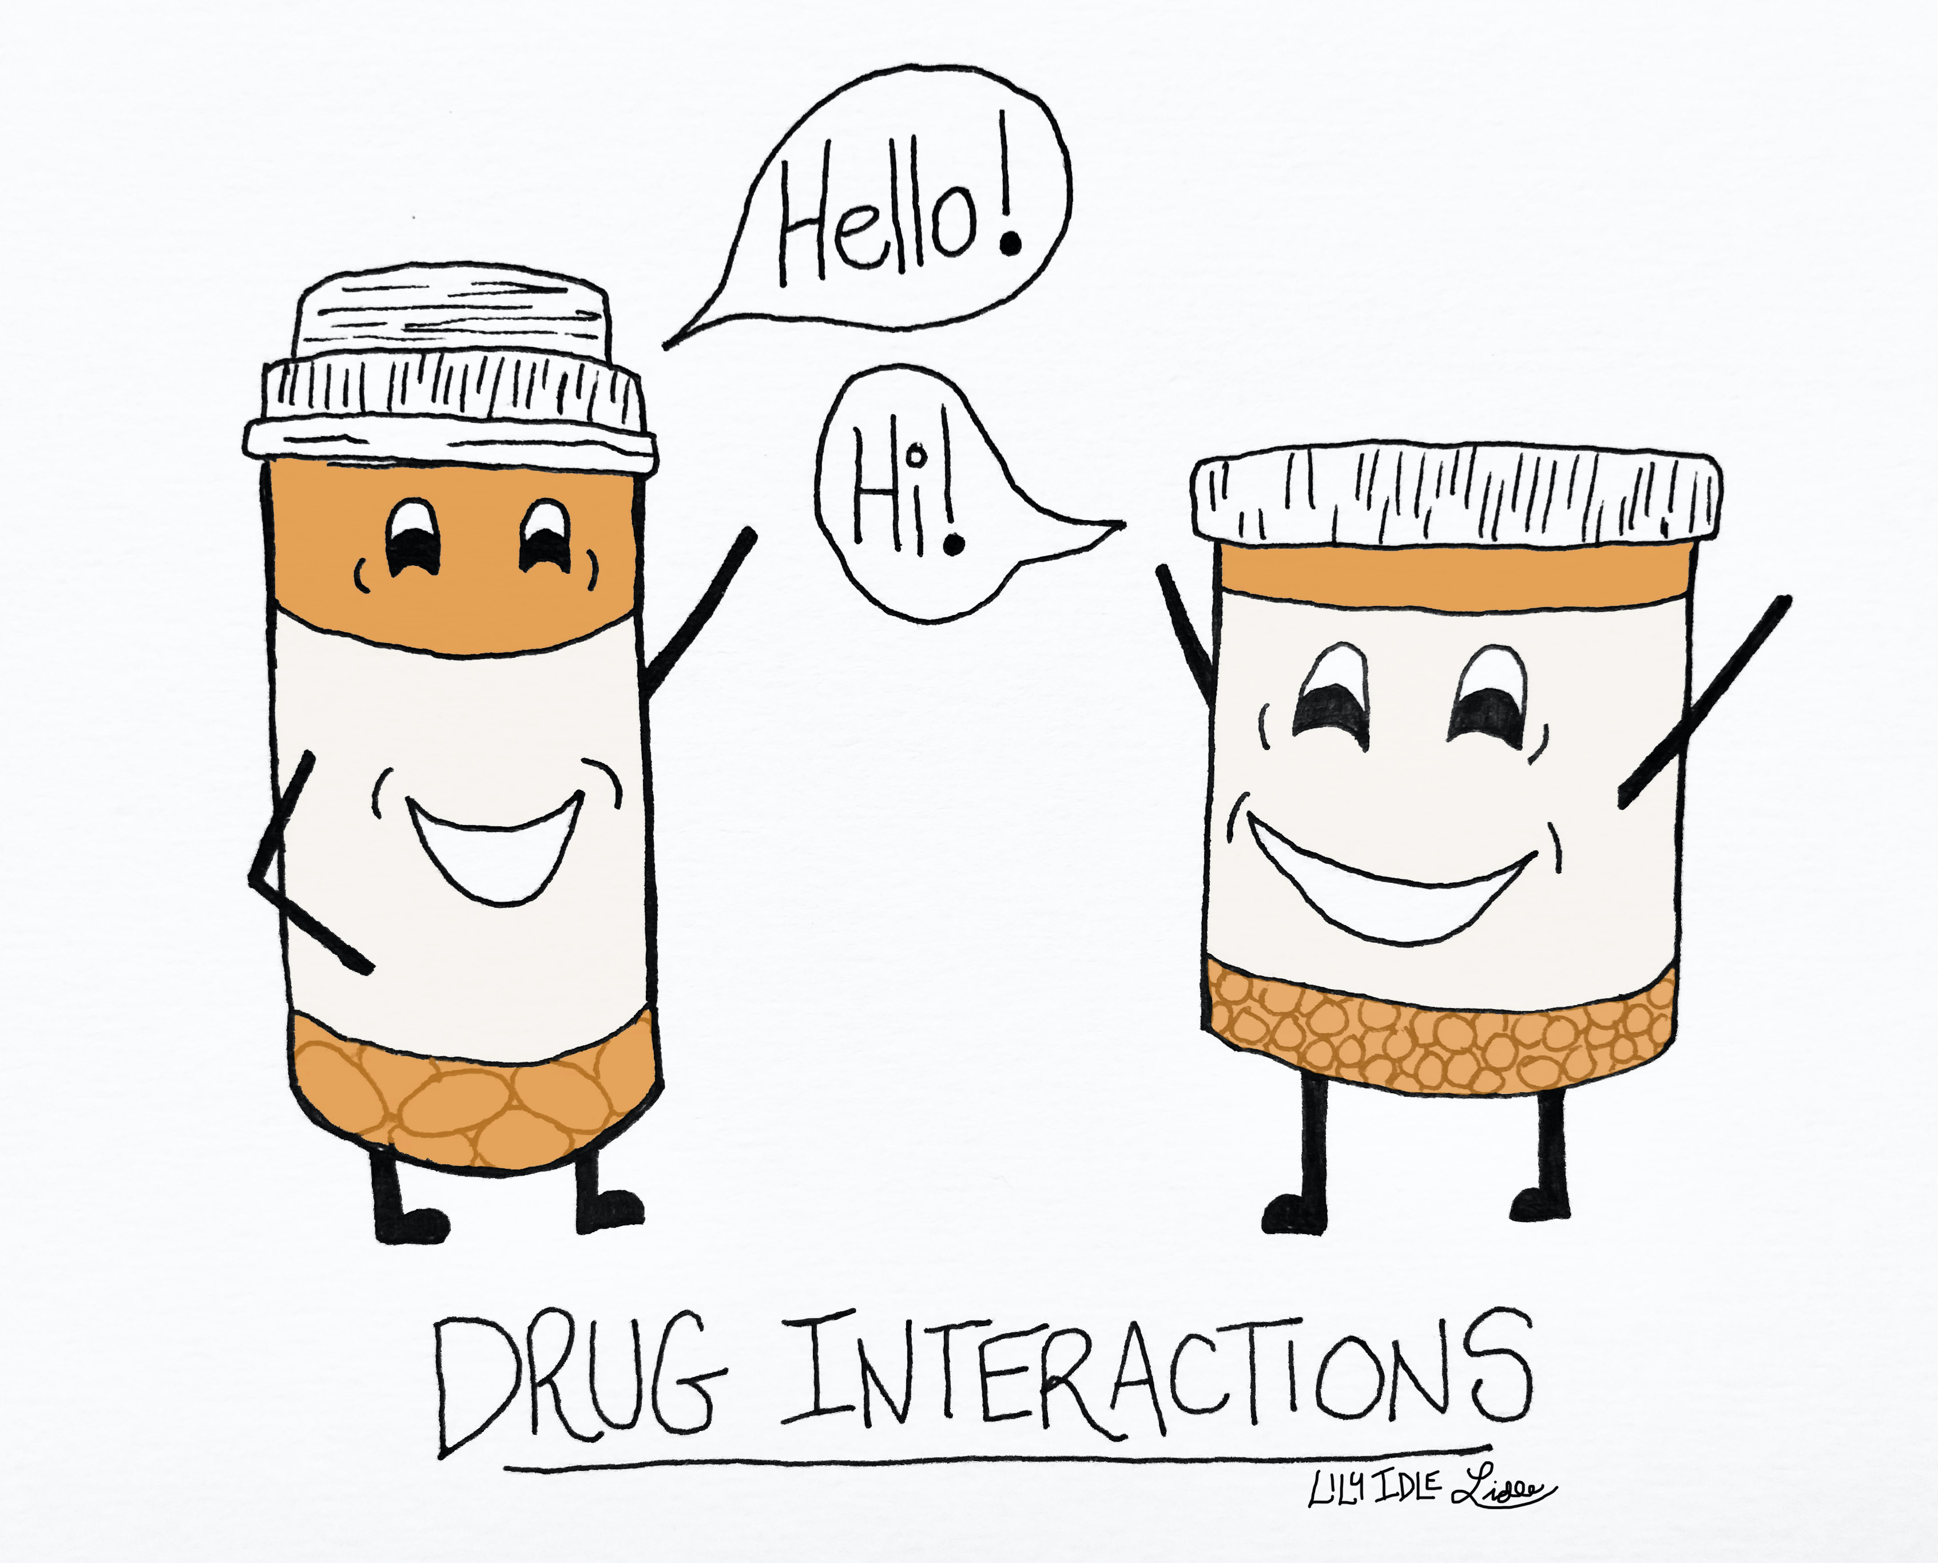
Drug-Target Interaction Prediction using
K-Nearest Neighbour Algorithm
SYSC 5405 – Pattern Classification and Experiment Design
Pitch Presented by Group – 7
Aditi Biswas (101193708)
Soham Patel (101184663)
Sai Gouthami (101212227)

Slide 2
CONTENTS
DATA VISUALIZATION
DATA PREPROCESSING
TRAINING
TESTING
PREDICTED PRECISION
META-LEARNING APPROACH

Slide 3
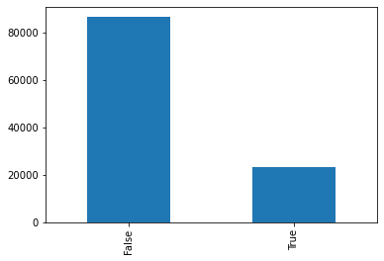
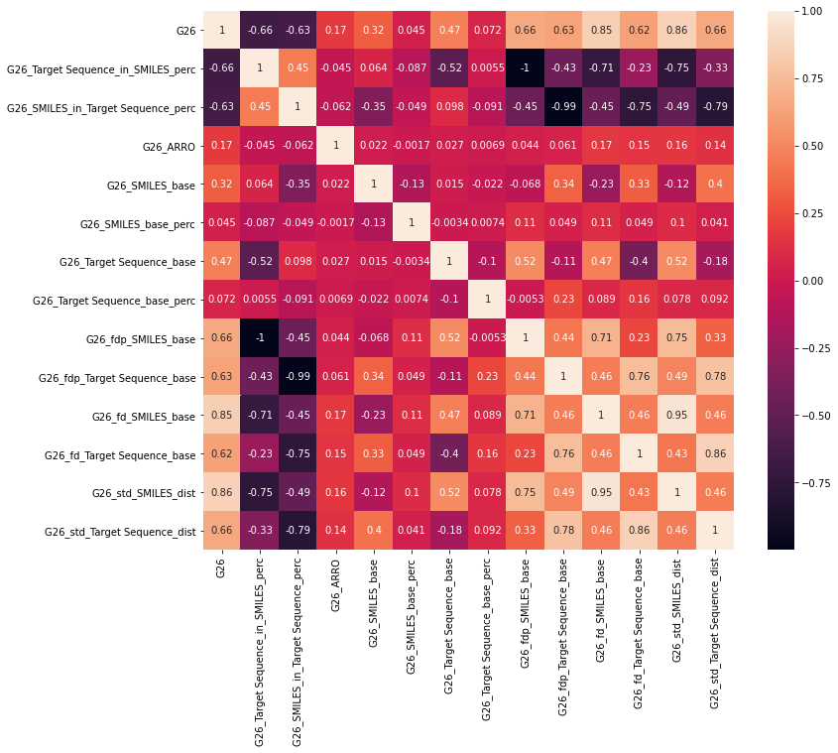
DATA VISUALISATION
CLASS IMBALANCE
HEAT MAP

Slide 4

DATA PREPROCESSING
DATA NORMALIZE – STANDARD SCALER
DATA SPLIT
(StratifiedKFold)
Train dataset (100720)
Test dataset
(8759)
21% to 40%
CLASS IMBALANCE

Slide 5
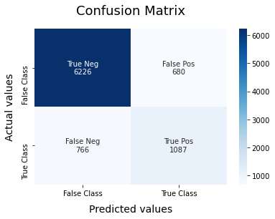




TRAINING – 5-FOLD CV
Precision: 0.62 Accuracy: 0.83
Precision: 0.62 Accuracy: 0.83
Precision: 0.61 Accuracy: 0.83
Precision: 0.62 Accuracy: 0.83
Precision: 0.62 Accuracy: 0.83

Slide 6

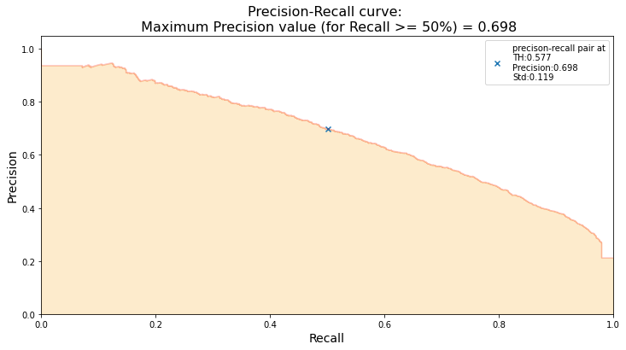
TESTING
PRECISION | ACCURACY
0.63 | 0.84

Slide 7

PREDICTED PRECISION
0.428 ± 0.119

Slide 8

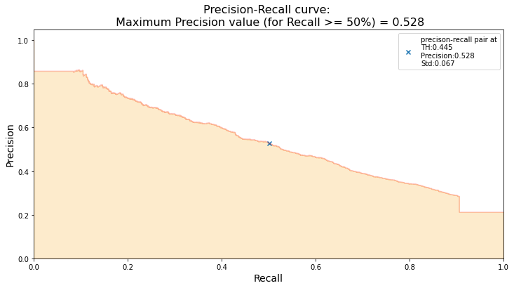
META LEARNING APPROACH - BAGGING
PRECISION | ACCURACY
0.55 | 0.79

Slide 9


